Slide 1

Christu Jyothi institute of technology and science
Department of computer science & engineering
a
Mini project presentation
on
2048 Game using python
PRESENTED BY:
G.Rachana (22681A0535)
K.Sushmitha (22681A0553)
A.Sai Kumar (22681A0503)
D.Vijay Kumar (22681A0523)
Project Guide: Mr. M.Uay Kumar
(Assistant professor))

Slide 2
CONTENTS
Title
Abstract
Introduction
Literature Survey
Existing System
Proposed System
System Architecture
Modules
System Requirements
Output Screen
Conclusion
Further Enhancement

Slide 3
TITLE:
2048 Game
Explore the classic puzzle game with exciting new features!
The title "2048" refers to the target tile value players aim to reach by merging smaller numbered tiles. It represents the final goal of the game — creating a single tile with the number 2048.

Slide 4
ABSRACT
The 2048 game is a well-known single-player puzzle where players combine numbered tiles by sliding them on a grid to reach the 2048 tile. This project enhances the classic version by introducing several user-friendly features aimed at improving the overall gameplay experience. An Undo feature allows players to reverse their last move, offering more strategic flexibility and reducing frustration from accidental swipes. The Pause and Play functionality lets players temporarily stop the game and resume at their convenience, catering to casual play styles. A Timer tracks the duration of each session, encouraging players to improve not only their score but also their speed. Additionally, a High Score tracker records the best score across multiple sessions, providing a performance benchmark and fostering a sense of achievement. These added features preserve the game's original challenge while making it more engaging and accessible for a wider audience.

Slide 5
Introduction
2048 is a popular single-player puzzle game created by Gabriele Cirulli in 2014. The goal is to slide and merge numbered tiles on a 4x4 grid to reach the 2048 tile. With simple rules and addictive gameplay, it quickly became a viral sensation and inspired many variations.

Slide 6
LITERATURE SURVEY
Gabriele Cirulli (2014)
Developed the original 2048 game as a simple, addictive puzzle on a 4×4 grid.
Wu & Kuo (2016)
Proposed an AI approach using expectimax algorithm to improve automated 2048 gameplay.
Wu, Tsai & Lee (2018)
Enhanced 2048 AI by integrating reinforcement learning for better move prediction.

Slide 7
Sharma & Singh (2019)
Implemented undo and timer features to improve user interaction and gameplay experience.
Patel & Shah (2020)
Added high score tracking and pause/play controls for enhanced user engagement.
Kumar et al. (2022)
Studied optimization techniques to improve tile merging algorithms and game efficiency.

Slide 8
EXISTING SYSTEM
🎮 Features
4x4 grid with numbered tiles
Tiles merge when moved in the same direction with equal value
Goal: Create a tile with the value 2048
Basic swipe/move control (keyboard or touch)

Slide 9
❌ Limitations
No pause or resume functionality
No high score tracking across sessions
No timer to track gameplay duration
No option to reset high score
No undo or reset (restart) feature

Slide 10
Proposed system
🎮 Core Features
Classic 2048 gameplay: merge tiles to reach 2048
Swipe controls (keyboard or touch)
Automatic tile merging and score tracking
🚀 Added Features
Feature Description
⏸️ Pause & Play :Ability to pause and resume the game at any time
🏆 High Score: Tracks and displays highest score achieved across sessions

Slide 11
🔄 Reset :Resets the current game board and score
🧹 Reset High Score: Clears the stored high score manually
⏱️ Timer :Displays time spent in the current game session
🔙 Undo (optional): Revert to previous game state (last move)
🎯 Benefits
Improved user engagement
Progress tracking with high scores and time
More control with pause/play and reset options

Slide 12
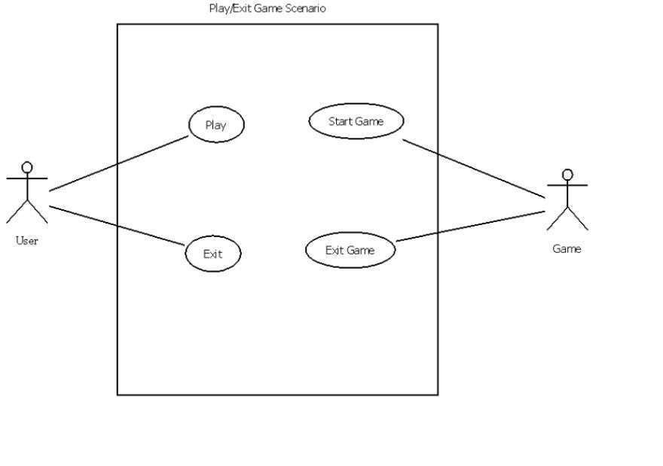
SYSTEM ARCHITECTURE
Use Case Diagram

Slide 13
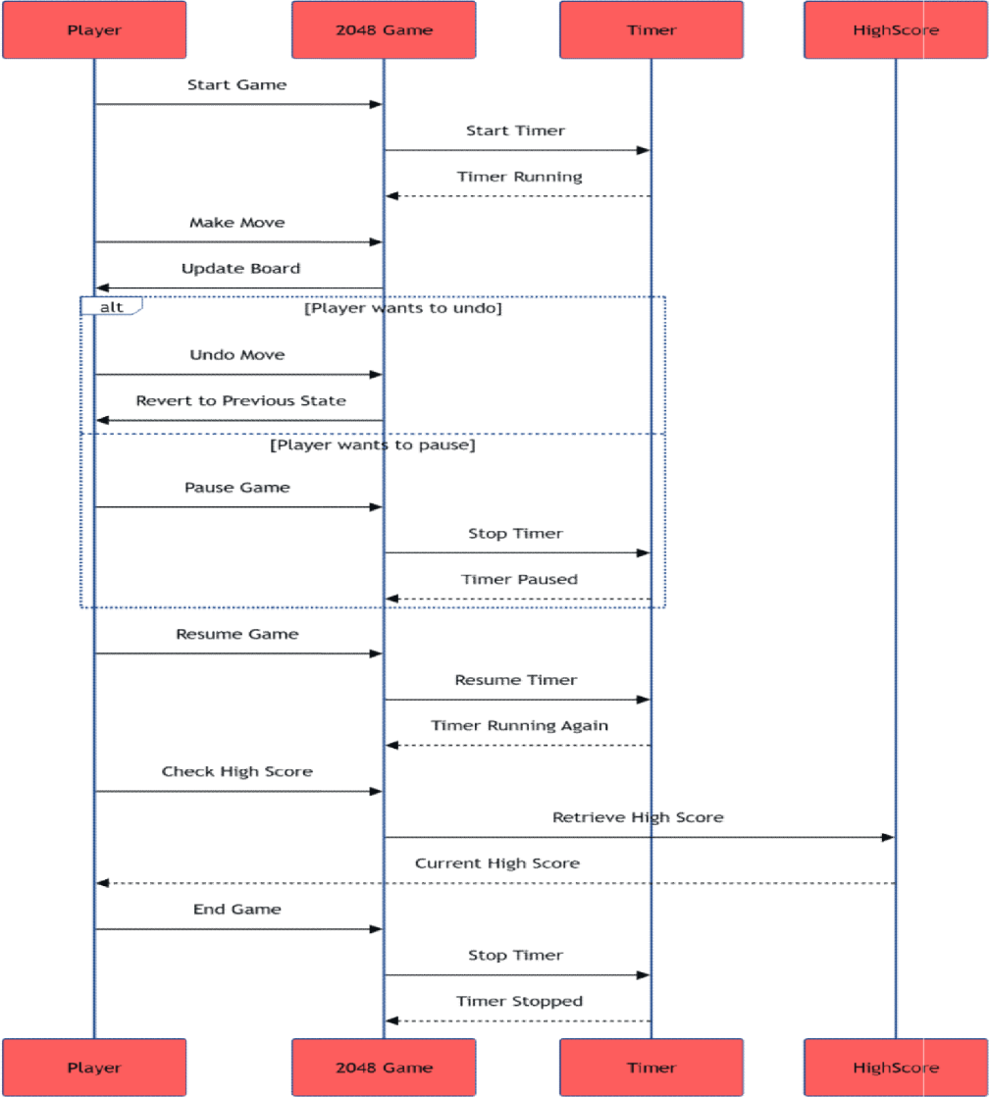
Sequence Diagram

Slide 14
MODULES
👤 User Modules
Game Board Interface – Interactive 4x4 grid for gameplay
Swipe/Key Controls – Allows movement of tiles (keyboard/touch)
Score & High Score View – Real-time score display
Pause / Resume – Option to pause and continue game
Timer Display – Shows time elapsed
Reset & Reset High Score – User-triggered game reset or score clear
🛠️ Admin Modules (Optional / For Advanced Systems)
Mostly applicable in web/app-based implementations
User Activity Logs – Track game sessions
Scoreboard Management – View/delete high scores (if multi-user)
Game Configurations – Manage default settings (e.g., tile colors, size)

Slide 15
📊 Data Processing Modules
Score Calculation – Adds points based on tile merges
High Score Storage – Saves high score using local or file-based storage
Timer Tracking – Calculates and updates game duration
State Management – Maintains board state and move history
🐍 Python (Backend/Game Logic) Modules
Game Engine – Core logic for tile movement and merging
Input Handler – Captures and interprets user input
Random Tile Generator – Adds new tiles (2 or 4) in empty spots
Undo Manager – Stores previous states for undo functionality
Storage Module – Saves high scores and game progress (e.g., using files or JSON)

Slide 16
Hjljklk;iuoihljlnnknlnklkjlnklnnk
System Requirements
Hardware Requirements
To implement the system, the following hardware requirements must be met:
Processor: Minimum Core i5 processor
RAM:2GB(minimum) or 8GB(recommended)
Hard DiskSpace:50GB or more
Software Requirements
The following software requirements must be met to implement the system:
Programming Language :Python 3.12.4
Operating System:Windows10 or later versions of Windows

Slide 17
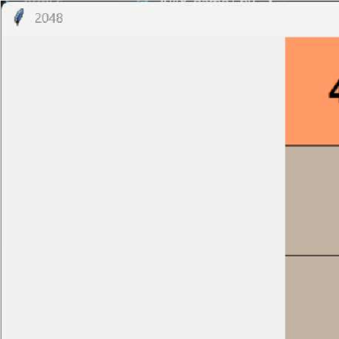
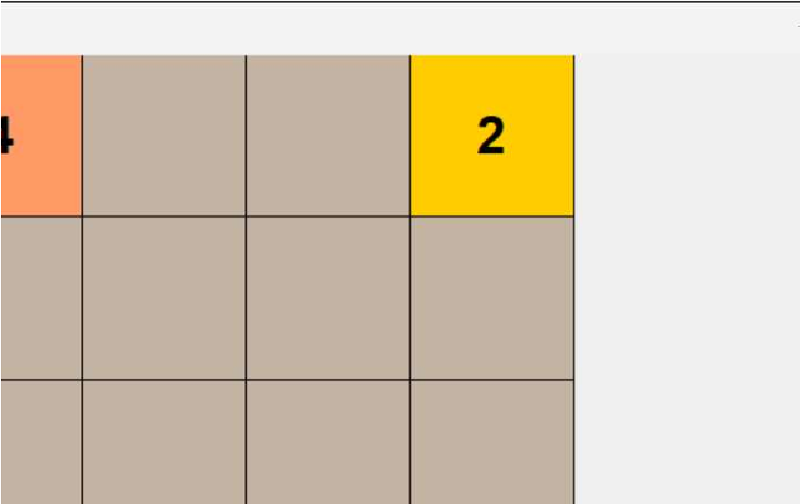

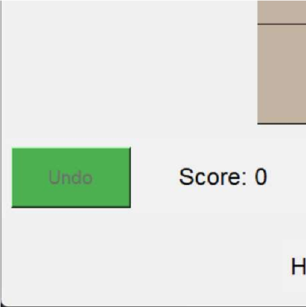
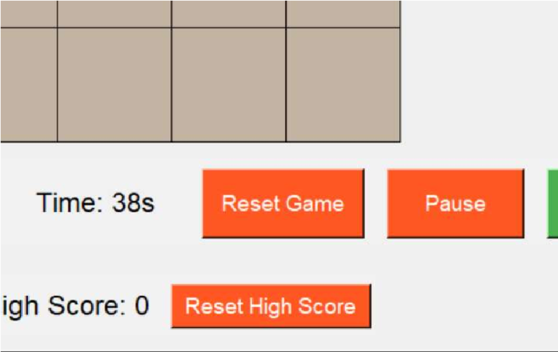

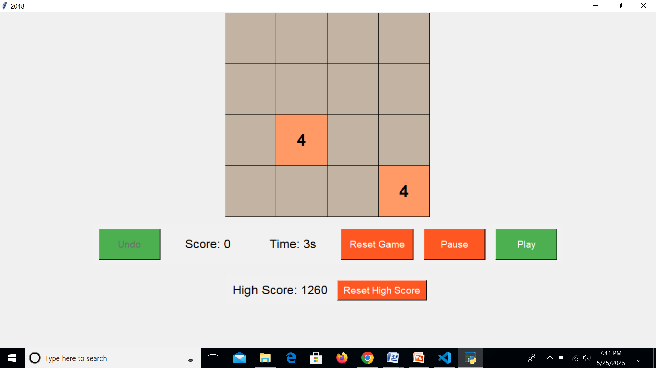
OUTPUT SCREEN

Slide 18
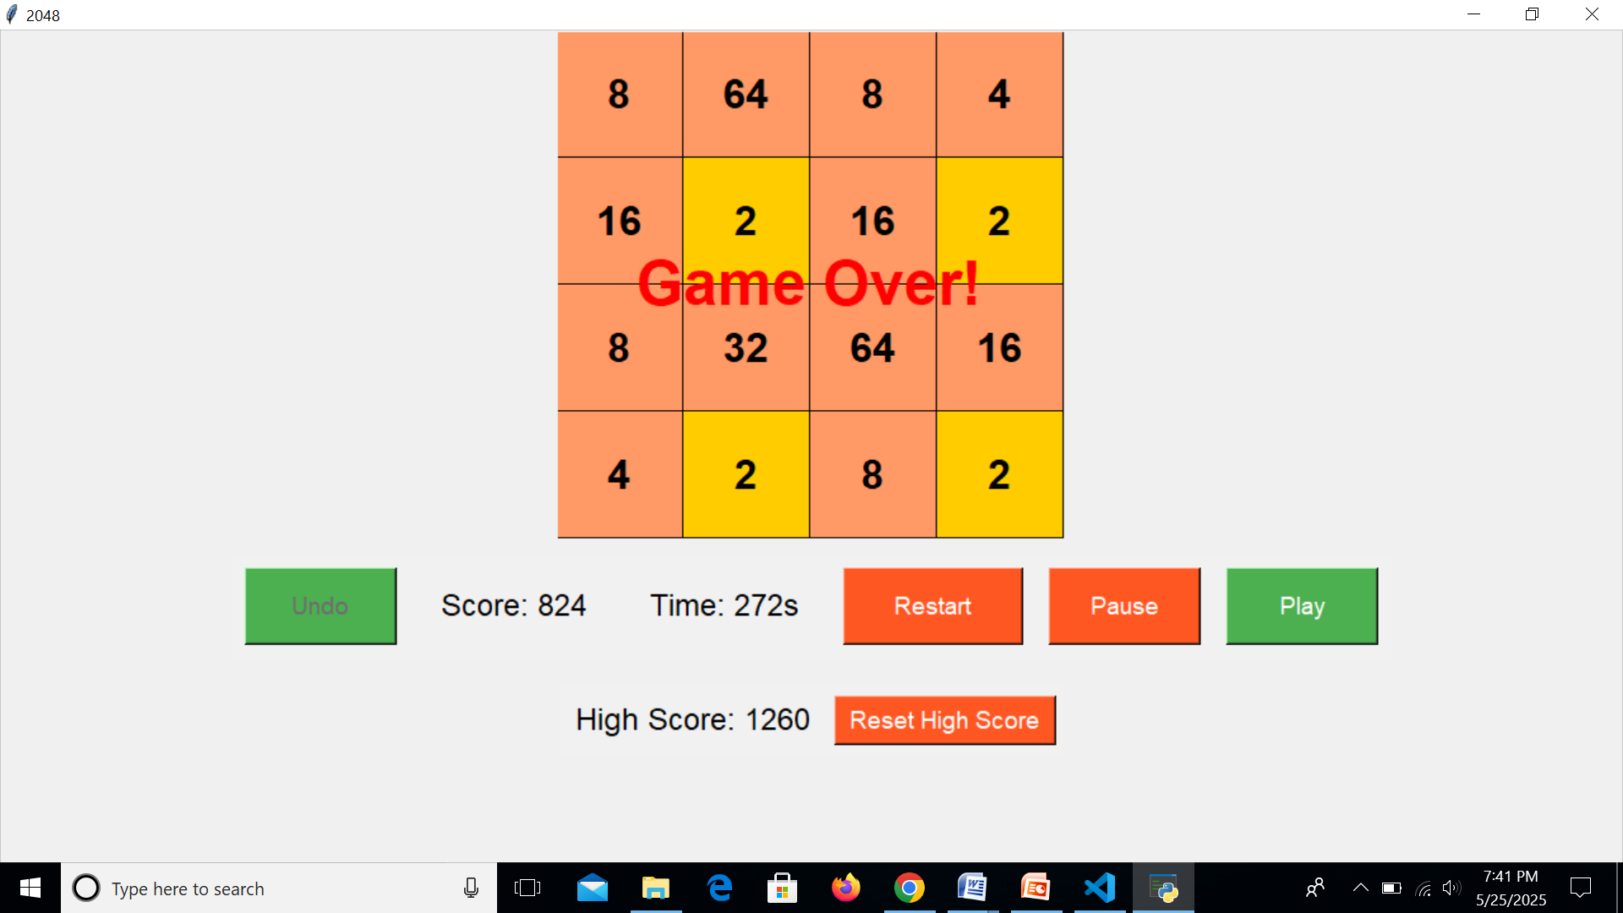

Slide 19
Conclusion
In conclusion, the new features of the 2048 game significantly enhance the player experience by adding strategic options and competitive elements. Whether you're using the undo functionality to fix a mistake, taking a breather with the pause option, or aiming for a new high score, these additions make the classic game even more fun!

Slide 20
Further Enhancement
Add online multiplayer mode for real-time competitive gameplay
Introduce AI-based move suggestions to assist players
Implement custom themes and tile skins (e.g., dark mode, seasonal themes)
Add achievement system (badges, trophies, milestones)
Include daily and weekly challenges
Enable voice control or accessibility support features
Provide sound effects and background music customization

Slide 21


